Slide 1
Neural Networks – Layout, traning, usage

Slide 2
Outline
Motivation for Neural Networks
Layout of Neural Networks
Universal function approximator
Training
Backpropagation
Overfitting
Usages via exercises.
Regression & Classification

Slide 3
Motivation
Chat – GPT

Slide 4
Layout of Neural Networks
Layers and neurons
Role of activation
Different activation functions
How big should a network be?
Orchams razor

Slide 5
Training
Backpropagation
Methods for avoiding overfitting
Early-stopping, batch-sizing, drop-out ....
Reproducibility
Let’s go through some examples

Slide 6
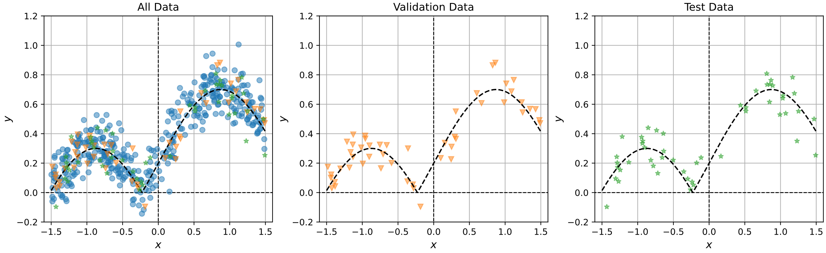
Training – Exercise 53
Perform regression on data
Influence of batch-sizing and early-stopping

Slide 7
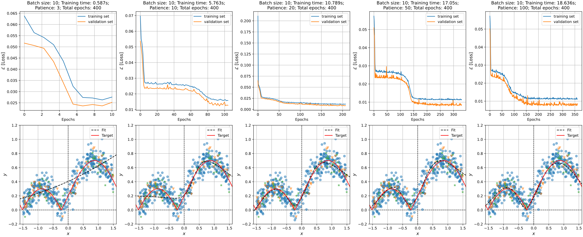
Exercise 53

Slide 8
Training – Exercise 58
Perform classification of atoms

Slide 9
Other considerations – Exercise 62
Hard to predict energies?
Perhaps limited by expressivity
Tight-binding → Orbitals have spatial dependence

